Slide 1

Introduction to Operating Systems CS/COE 1550
Spring 2020-2021
Sherif Khattab
ksm73@pitt.edu
(Some slides are from Silberschatz, Galvin and Gagne ©2013)

Slide 2
Announcements
Upcoming deadlines:
4/9: Lab 4
4/13: Homework 11 and Quiz 3 – to be posted today
4/16: Homework 12
4/23: Lab 5
4/26: Project 4 (File System) – to be posted today
5/2: Quiz 4
Tophat questions due one week after each lecture

Slide 3
Last Lecture …
File System Implementation
Allocating blocks to files
contiguous
linked
FAT
indexed
hybrid

Slide 4
Muddiest Points (1/3)
File Allocation Methods
What happens when a memory chunk is deallocated in contiguous allocation?
File Allocation Table
UNIX Fast File System
How Unix keeps track of which files are direct, single-leveled, double-leveled, etc.
2-level indexing
Explanation of where each value in the maximum file size equation comes from
multi-level block indexing allocation pros & cons
Offset calculation
what is logical and physical in mapping？ are these addresses

Slide 5
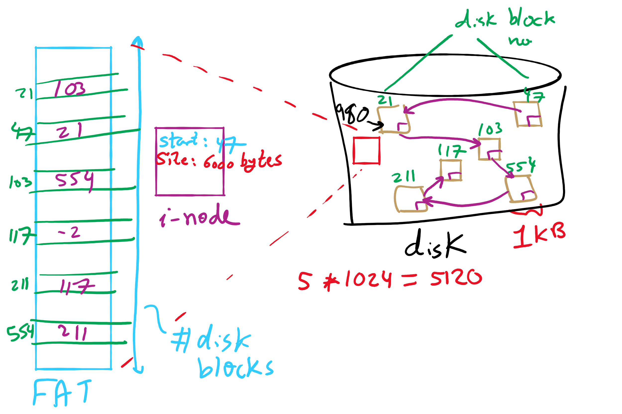
FAT Example

Slide 6
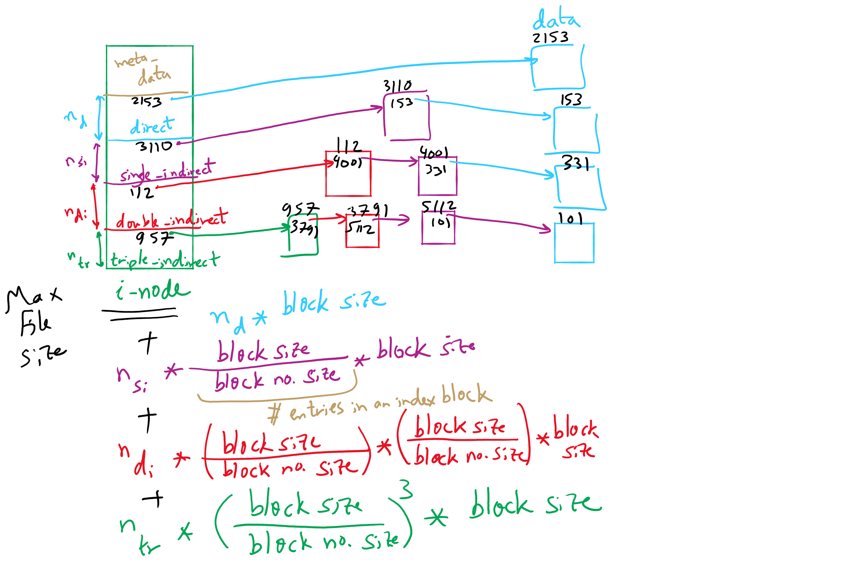
FFS and Max File Size

Slide 7
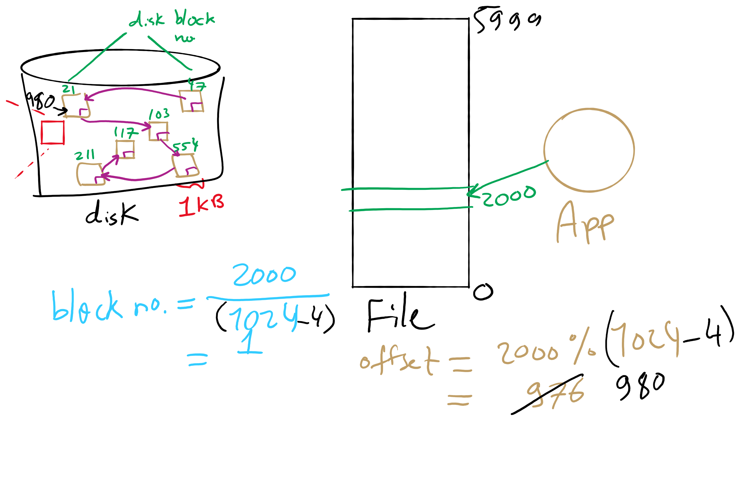
Address Translation

Slide 8
Muddiest Points (2/3)
File Allocation Methods (contd.)
implementation of allocation schemes
max file size
code for linked allocation
What does the integer j count in the linked allocation for loop? Why cant you just follow the block pointers until you reach a null pointer?
Could you give an explanation about what data structure we should use to implement linked list file system
A few of the calculations were hard to keep track of, would you be able to compile them all together so that we can reference them pretty easily or run through the general logic behind them?
Pros and cons of each of the memory storage ideas

Slide 9
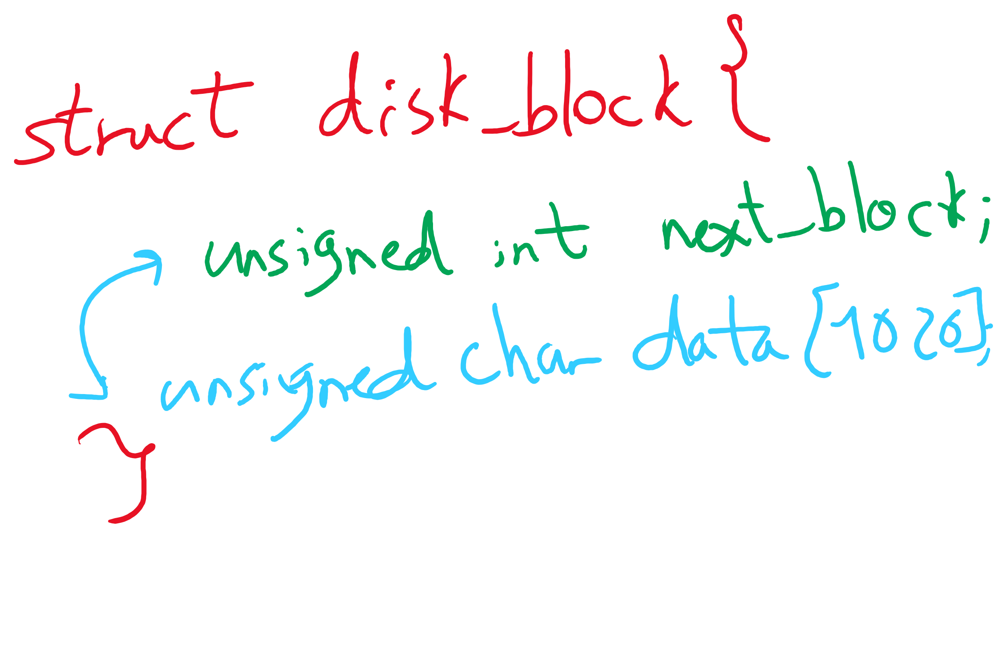
Data Structures for Linked Allocation

Slide 10
Muddiest Points (3/3)
Tophat question
3rd tophat question. Why does the offset calculation change but not the for loop?
The second top hat question
Lab 4
HW10 Q4 Q11
What is transferring files? Moving them around or transferring the information from the file to the process requesting it?
practice for all these calculations (page number/page size, emat, etc), could we get a set of practice problems for the final?

Slide 11
Today’s Agenda …
File System Implementation
Directories
Free block management
Optimizing reliability and performance

Slide 12
What’s in a directory?
Two types of information
File names
File metadata (size, timestamps, etc.)
Basic choices for directory information
Store all information in directory
Fixed size entries
Disk addresses and attributes in directory entry
Store names & pointers to index nodes (i-nodes)
attributes
games
attributes
games
mail
attributes
mail
attributes
news
attributes
news
attributes
research
attributes
research
Storing all information in the directory
Using pointers to index nodes
attributes

Slide 13
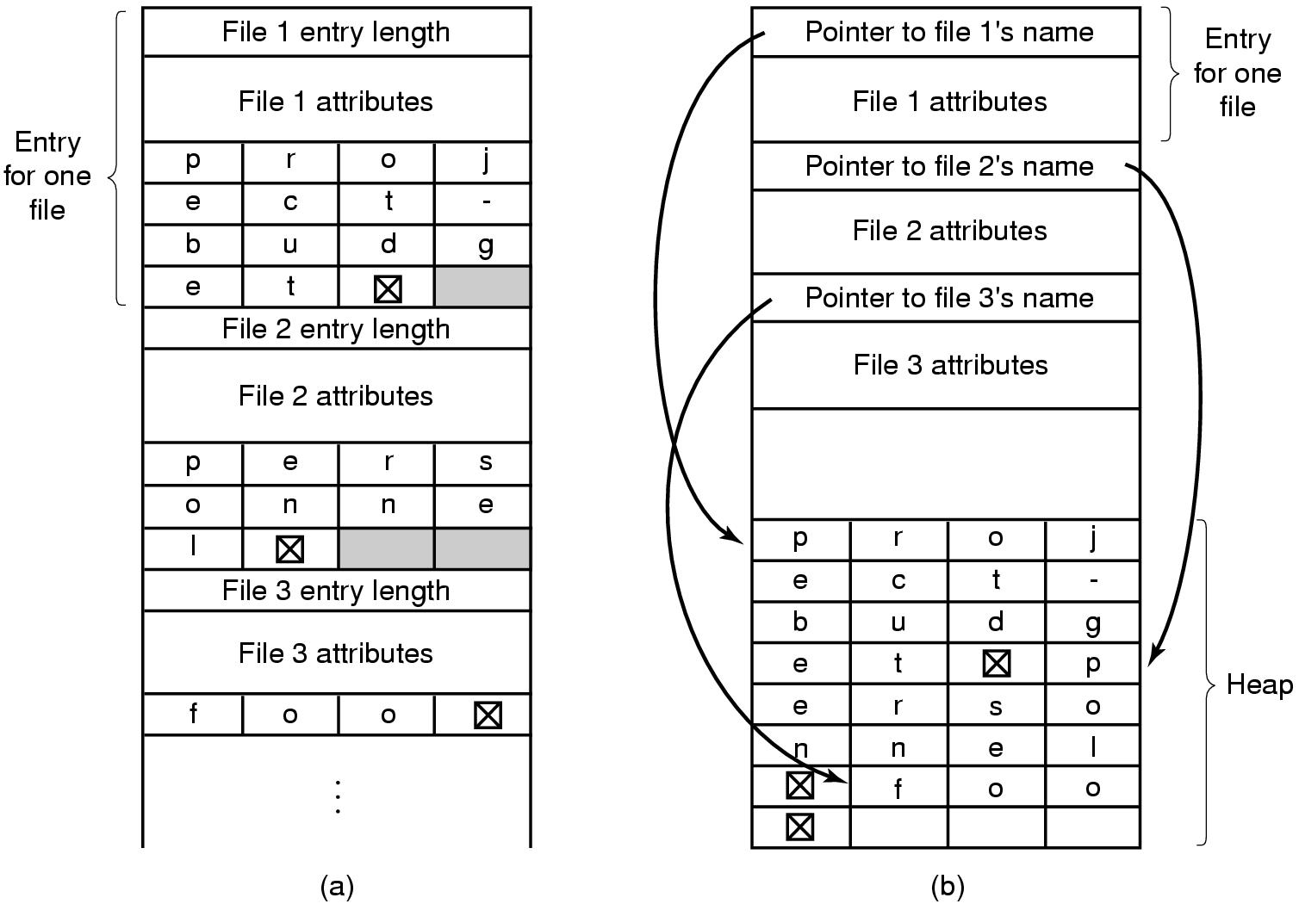
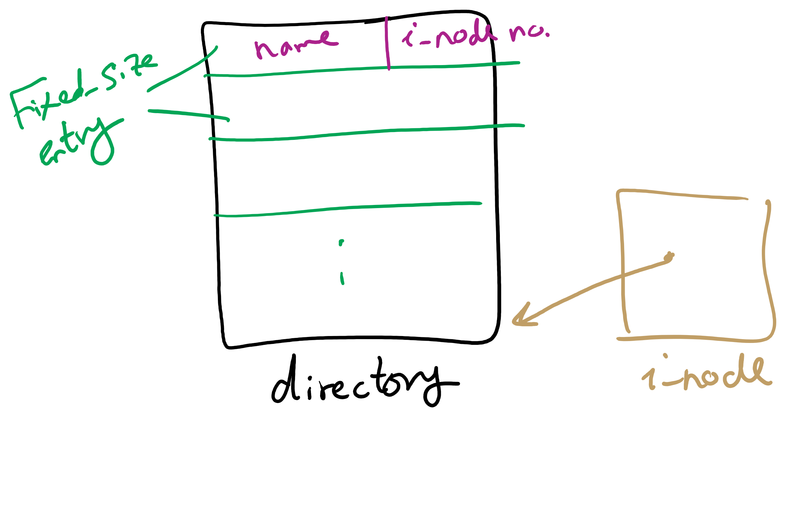
Handling long file names in a directory

Slide 14
Directories in FFS
Directories in FFS are just special files
Same basic mechanisms
Different internal structure
Directory entries contain
File name
I-node number
Other Unix file systems have more complex schemes
Not always simple files…
Directory
inode number
record length
name length
name
inode number
record length
name length
name

Slide 15
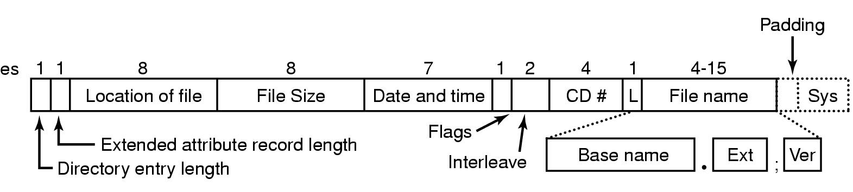
CD-ROM file system

Slide 16
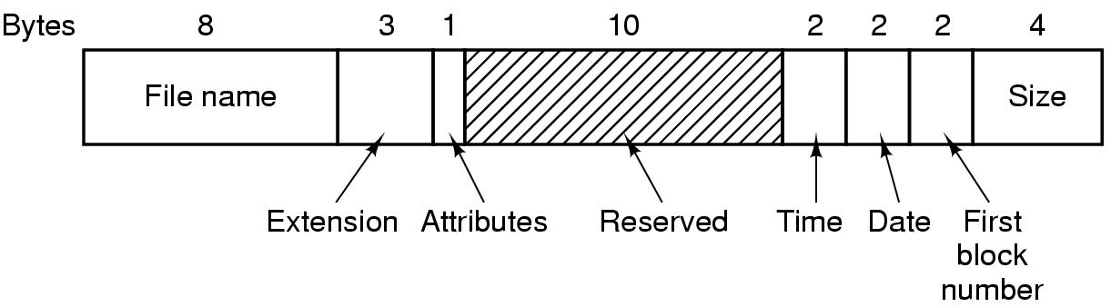
Directory entry in MS-DOS

Slide 17
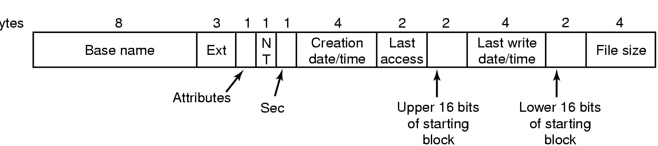
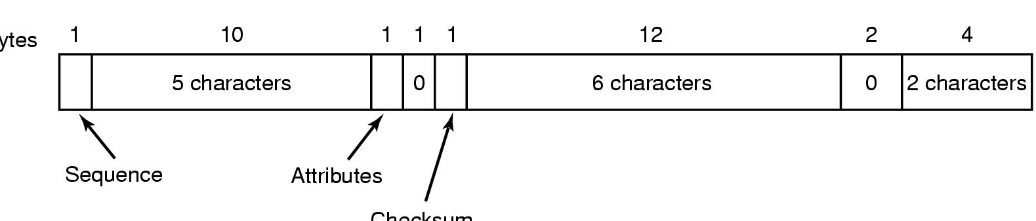
FAT32 Directory and Filename
Bytes
Checksum

Slide 18
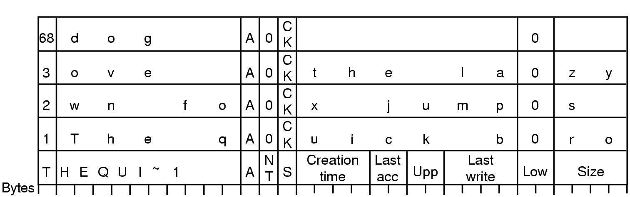
Storing a long name in FAT32
Long name stored in Windows 98 so that it’s backwards compatible with short names
Short name in “real” directory entry
Long name in “fake” directory entries: ignored by older systems
OS designers will go to great lengths to make new systems work with older systems…

Slide 19
Sharing files
Root directory
A
B
C
A
Papers
A foo
A
Photos
B foo
B
Photos
C bar
C foo
C blah
A os.tex
A sunset
A
Family
B lake
A sunset
A kids
? ???

Slide 20
Solution: use links
A creates a file, and inserts into her directory
B shares the file by creating a link to it
A unlinks the file
B still links to the file
Owner is still A (unless B explicitly changes it)
A
A
B
B
b.tex
b.tex
a.tex
a.tex
Owner: A Count: 1
Owner: A Count: 2
Owner: A Count: 1

Slide 21
Free Block Tracking
10

Slide 22
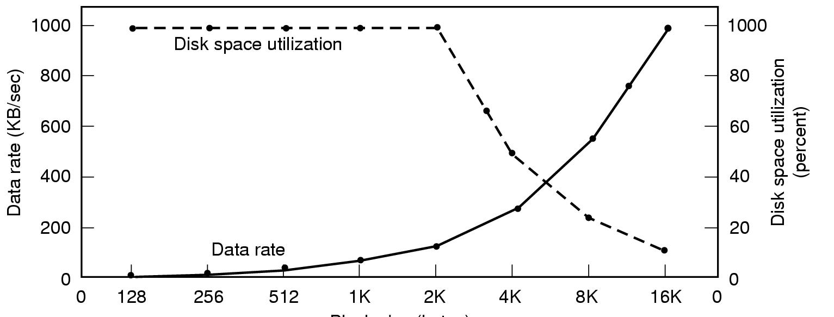
Disk block size
Dark line (left hand scale) gives data rate of a disk
Dotted line (right hand scale) gives disk space efficiency
All files 2KB
Block size

